Slide 1
Bankruptcy Prediction Model
Implemented Models and Evaluation
Group - 5
Rahman

Slide 2
Problem Statement
Importance of Bankruptcy Prediction:
Bankruptcy prediction is a critical task for various stakeholders, including financial institutions, investors, and policymakers. Accurate prediction can help in mitigating financial risks and enhancing the stability of the financial system. By identifying companies that are likely to go bankrupt, proactive measures can be taken to manage and reduce potential losses.
Challenges in Bankruptcy Prediction:
Predicting bankruptcy is challenging due to the complexity and variability of financial data. Companies have different financial structures, and economic conditions can change rapidly, impacting the accuracy of predictions. Traditional statistical methods may not capture the non-linear relationships in the data, necessitating the use of advanced machine learning techniques.
Impact of Accurate Prediction:
An accurate bankruptcy prediction model can provide early warnings, allowing stakeholders to take preventive actions such as restructuring debts, improving cash flow management, and making informed investment decisions. It also helps in regulatory compliance and enhances the overall health of the financial ecosystem.

Slide 3
Objective:
Developing Predictive Models:
The primary objective of this project is to develop and evaluate multiple machine learning models to accurately predict bankruptcy. The models considered include Logistic Regression, Random Forest, Gradient Boosting, Support Vector Machine (SVM), and Decision Trees. Each model brings a different approach to capturing patterns in the data, thereby providing a comprehensive analysis.
Comparative Analysis:
By implementing and comparing various models, we aim to identify the most effective algorithm for bankruptcy prediction. This involves not only assessing the accuracy of the models but also understanding their strengths and weaknesses in terms of precision, recall, F1-score, and AUC (Area Under the ROC Curve).
Model Selection for Deployment:
The ultimate goal is to select the best-performing model(s) for deployment in real-world scenarios. This involves not just looking at the highest accuracy but also considering model interpretability, computational efficiency, and the ability to handle unseen data robustly.

Slide 4
Data Overview
Dataset Description:
The dataset contains information on 250 companies with 7 features each. The features are designed to capture various risks and capabilities related to the companies financial and operational status.
Features:
  Industrial Risk: This shows the risk level of the industry in which the company operates
  Management Risk: This indicates the risk associated with the company's management practices.
  Financial Flexibility: This reflects how easily the company can manage its financial obligations.
  Credibility: This measures how credible or trustworthy the company is perceived to be.
  Competitiveness: This assesses how competitive the company is within its industry.
  Operating Risk: This shows the risk associated with the company's operations.
  Target Variable Class: This is the target variable that indicates whether the company went bankrupt or not.
  Initial Dataset Size: 250 samples
  Post-Preprocessing Size: 103 samples (after removing 147 duplicate entries)

Slide 5
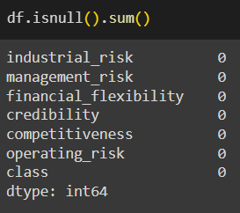
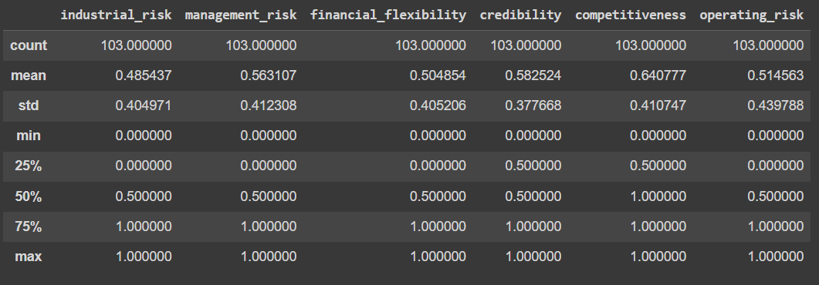
Data Preprocessing
Check for Null Values:
"Ensured no missing values."
Check for Duplicate Values:
"Identified duplicate records."
Dropping Duplicates:
"Removed duplicate entries."
Statistical Summary:
"Summarized data statistics."

Slide 6
Models Implemented
List of Models:
Logistic Regression
Random Forest
Gradient Boosting
Support Vector Machine (SVM)
Decision Trees
Brief Explanation:
1. Logistic Regression:
A linear model used for binary classification tasks. It models the probability that a given input point belongs to a certain class using the logistic function. Logistic Regression is interpretable and works well when the relationship between features and the target is approximately linear.

Slide 7
2. Random Forest:
An ensemble learning method that constructs multiple decision trees during training and outputs the mode of the classes (classification) of the individual trees. It reduces overfitting and improves accuracy by averaging multiple trees.
3. Gradient Boosting:
An ensemble technique that builds models sequentially, with each new model correcting errors made by the previous ones. It uses a gradient descent algorithm to minimize the loss when adding new models. Gradient Boosting is known for its high predictive accuracy.
4. Support Vector Machine (SVM):
A powerful classification method that finds the hyperplane which best separates the data into different classes. It works well for both linear and non-linear data through the use of kernel functions, making it versatile and effective in high-dimensional spaces.
5. Decision Trees:
A non-linear model that splits the data into subsets based on the value of input features, forming a tree structure. Each node represents a feature, each branch represents a decision rule, and each leaf represents an outcome. Decision Trees are simple to understand and interpret but can easily overfit.

Slide 8
Steps Involved in Model Building
Encoded the Target variable
Splitted the data set
Applied SMOTE Method to Balance the Target Variables
Standardize the data: Applying a standard scaler can be beneficial for many machine learning algorithms, especially those that rely on distance calculations (such as Logistic Regression, SVM, and Gradient Boosting).
Model Implementation: Applying Multiple models
Logistic Regression
Decision Tree
Random Forest
Gradient Boosting
SVM

Slide 9
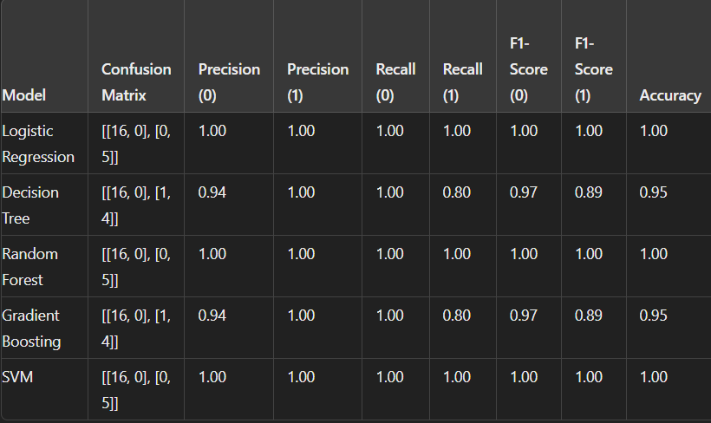
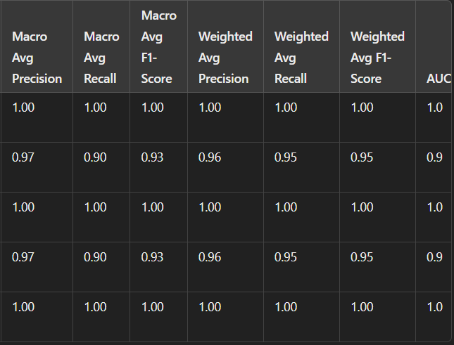
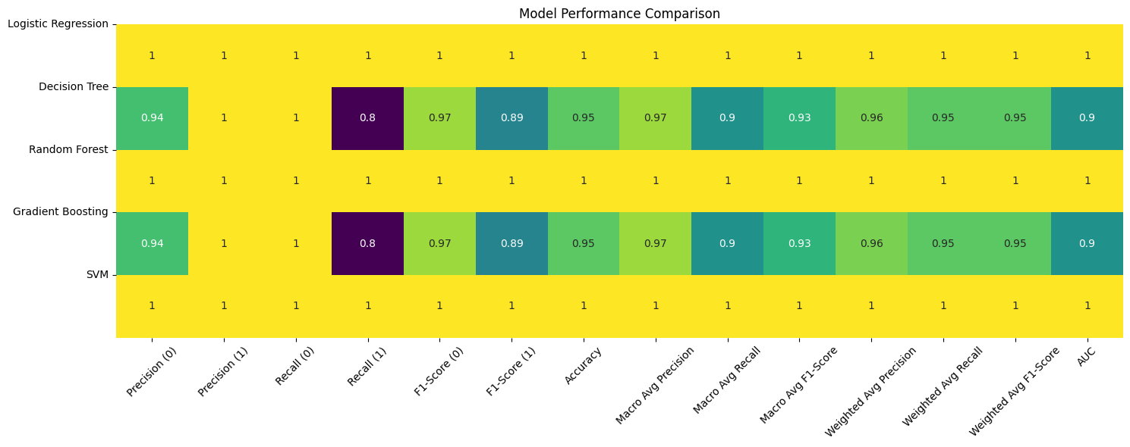
Classification Report:

Slide 10
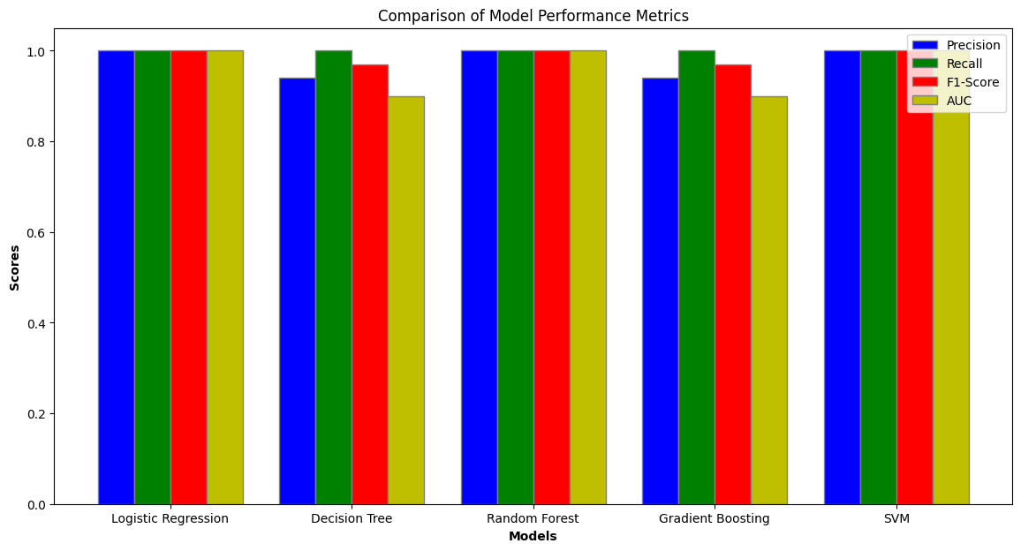
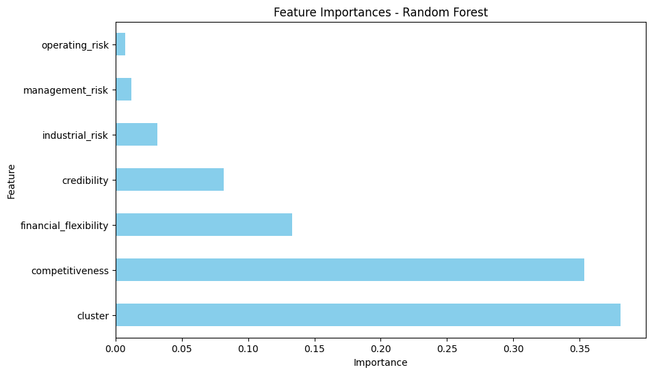
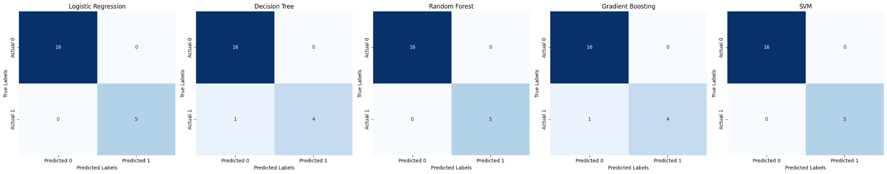
Comparison of Model performance, Feature importance & Confusion Matrices plot:

Slide 11
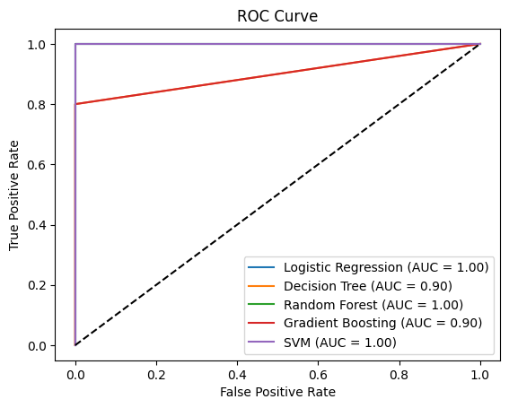
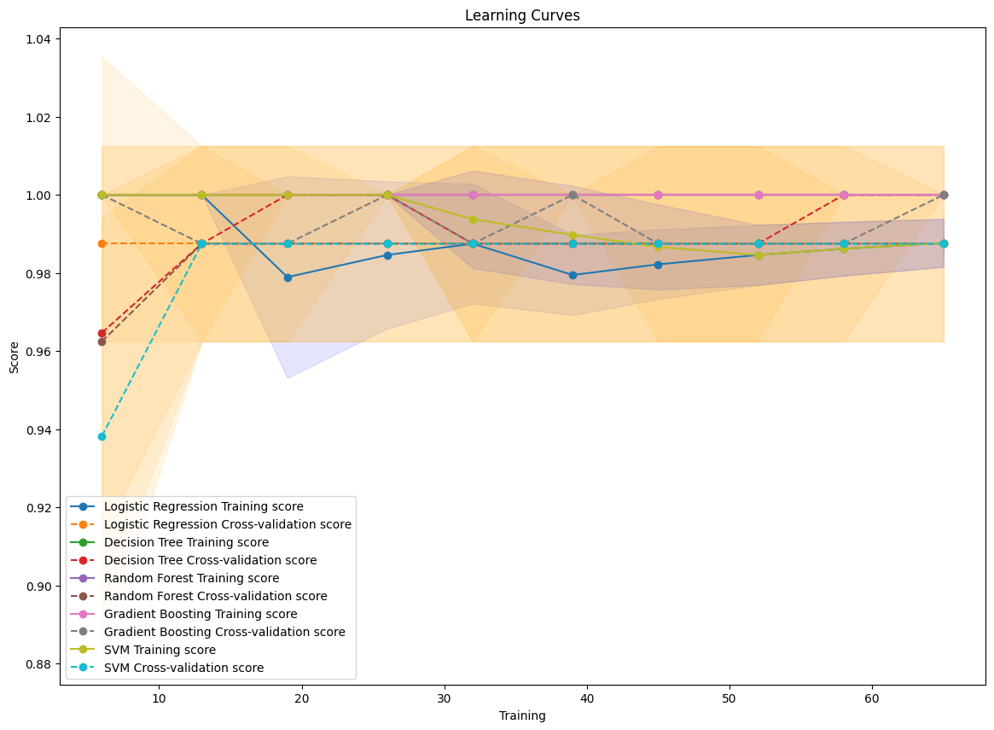
ROC Curve & Learning Curves:

Slide 12
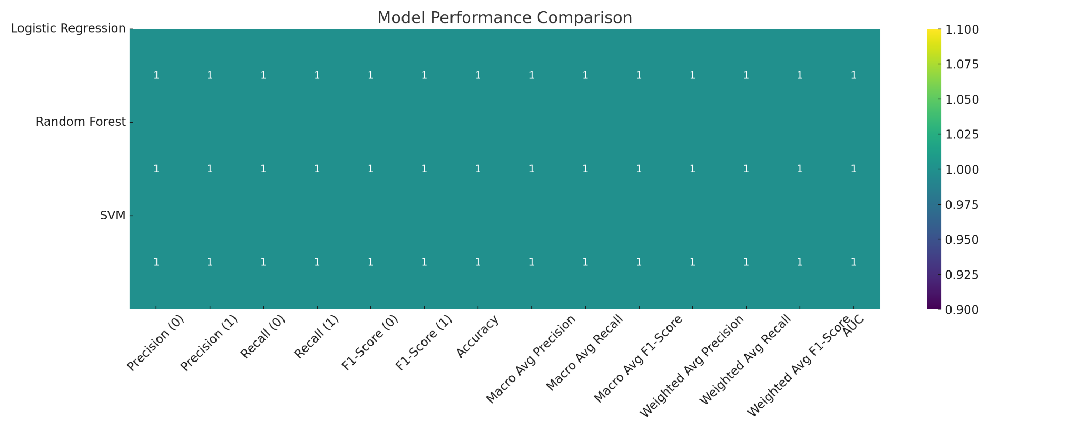
Hyperparameter Tuning for Logistic Regression, Random Forest and SVM:
Using GridSearchCV: If you have ample computational resources and the parameter grid is manageable, GridSearchCV ensures that you explore all possible combinations and guarantees finding the best combination within our grid.

Slide 13
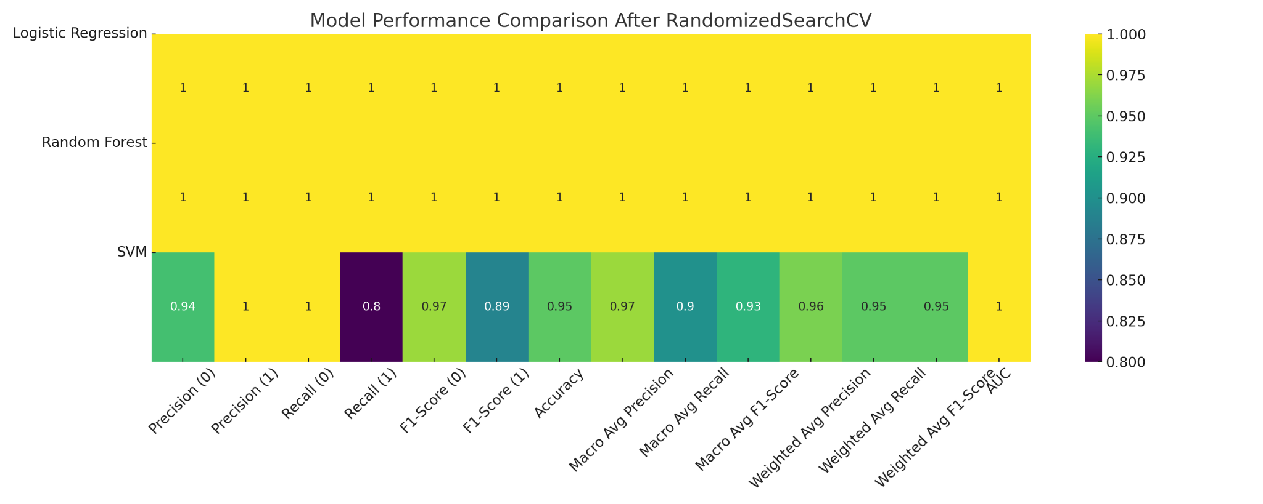
Using RandomizedSearchCV:
If you want to save time and computational resources or if the parameter space is large, RandomizedSearchCV is usually more practical. It allows you to get a good approximation of the best parameters without the exhaustive search.

Slide 14
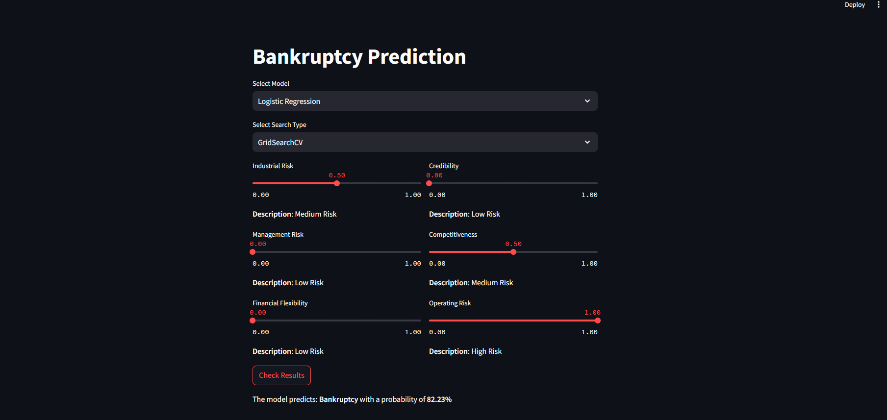
Deployment

Slide 15
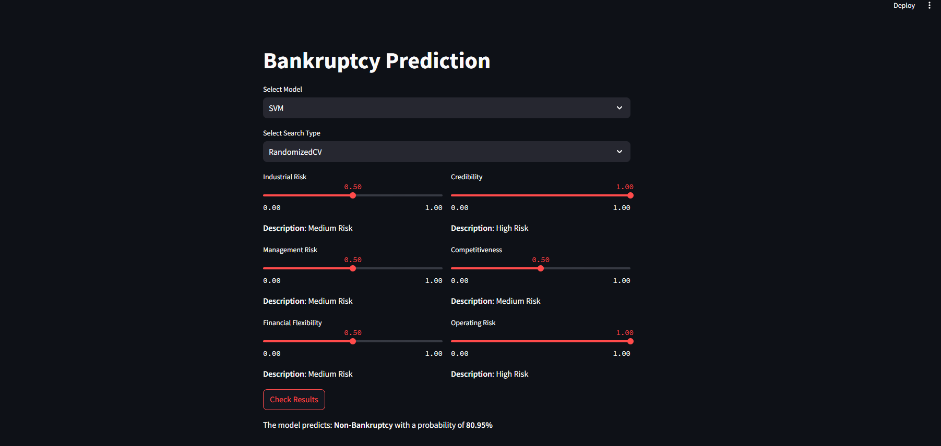

Slide 16
THANK YOU

